Slide 1
A Comparative Analysis of Job Application
Analysed By-
Deependra Kumar
Email: kumar.deependra073@gmail.com
LinkedIn:
https://www.linkedin.com/in/deepsdk4/

Slide 2
Introduction:
The project aims to analyze the personal job application data gathered over 3 months, capturing the important parameters including company name, job post, job type, location, required skills, compensation (CTC), Applied Through, Applied date, and additional comments. With a dataset comprising 278 entries, this analysis provides valuable insights into individual job search trends and strategies.
Note: This data is exclusively collected from my personal job applications. Any external usage should include a proper citation.
Last Updated: March 16, 2024

Slide 3
Steps
Data cleaning & Processing
Remove missing values or fill with the most frequent values depending on the situation
Drop the un-important columns
Process the columns parameter and clean & process the variable for ease of implication.
Exploratory data analysis (EDA)
Perform exploratory data analysis to uncover insights and patterns in the data.
Visualize key findings using charts and graphs to effectively communicate insights.

Slide 4
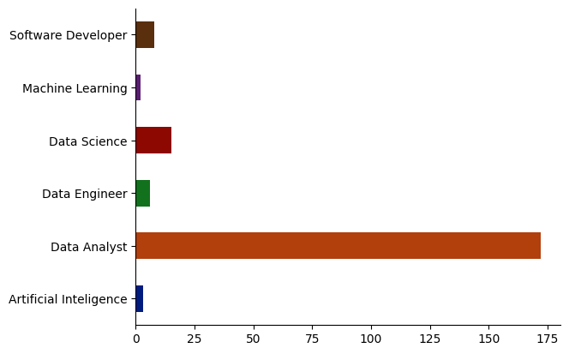
Applied Job Role
The data was visualized using both Python and Excel, and the results were compared.
Job_Role | Count of Job_Role
Artificial Intelligence | 3
Data Analyst | 172
Data Engineer | 5
Data Science | 16
Machine Learning | 2
Software Developer | 8

Slide 5
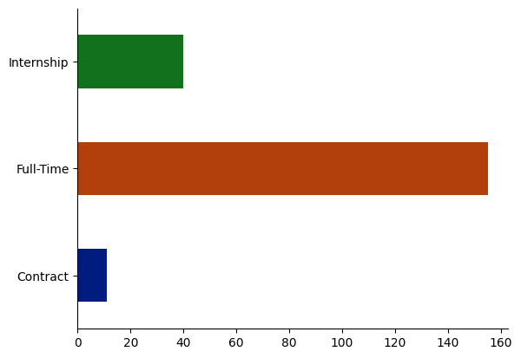
Applied Job Type
Role_Type | Count of Role_Type
Contract | 11
Full-Time | 155
Internship | 40

Slide 6
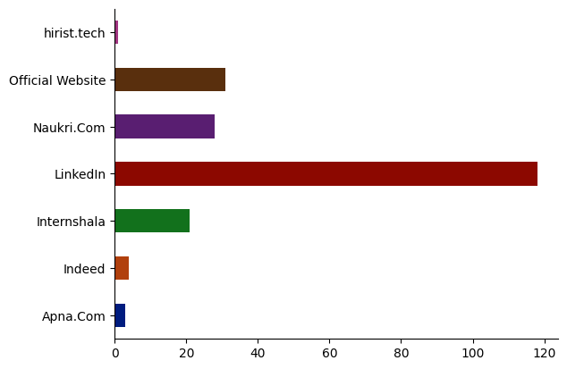
Applied Through
AppliedThrough2 | Count
Apna.com | 3
hirist.tech | 1
Indeed | 4
Internshala | 21
LinkedIn | 118
Naukri.Com | 28
Official Website | 31

Slide 7
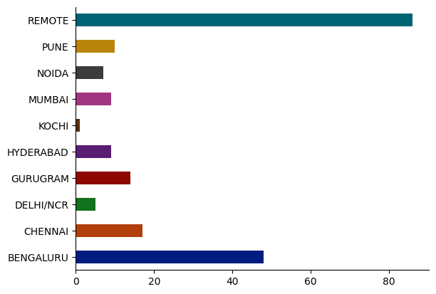
Applied Location
Location2 | Count of Location2
Bengaluru | 49
Chennai | 17
Delhi/NCR | 6
Gurugram | 14
Hyderabad | 6
Kochi | 1
Mumbai | 9
Noida | 6
Pune | 11
Remote | 87

Slide 8
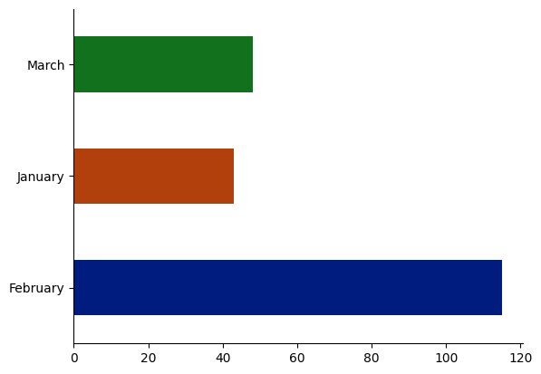
Month wise job applied
Month_Name | Count of Month_Name
January | 43
February | 115
March | 48

Slide 9
Bi-variate categorical analysis
Bivariate categorical analysis involves analyzing the relationship between two categorical variables.
Bivariate analysis allows us to explore how the categories of one variable relate to the categories of another variable.

Slide 10
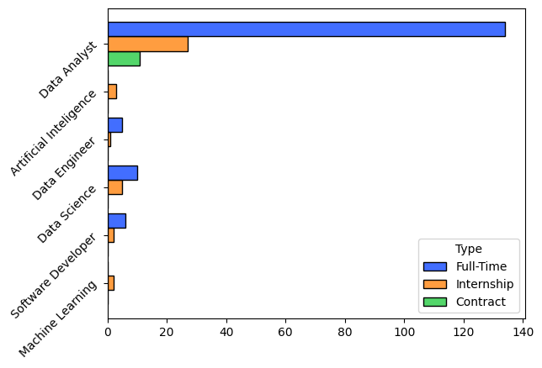
Applied Job role vs Job type
Job_Role | Contract | Full-Time | Internship
Software Developer |  | 6 | 2
Machine Learning |  |  | 2
Data Science |  | 11 | 5
Data Engineer |  | 4 | 1
Data Analyst | 11 | 134 | 27
Artificial Intelligence (AI) |  |  | 3

Slide 11
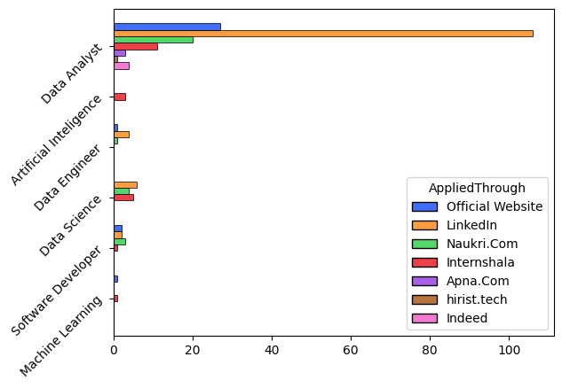
Applied Job role vs Applied through

Slide 12
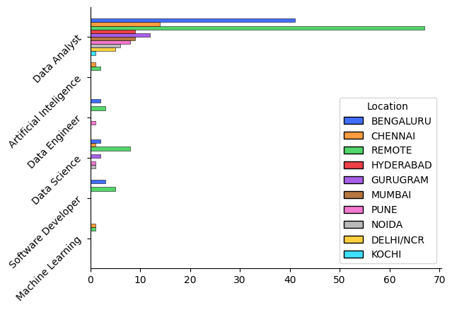
Applied Job role vs Location

Slide 13
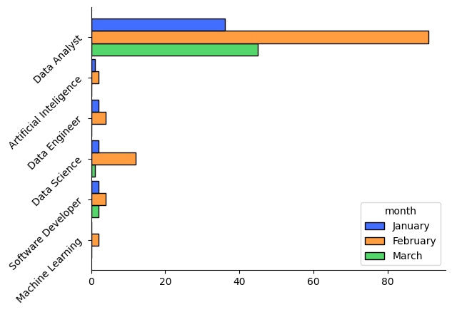
Applied Job role vs Applied month

Slide 14
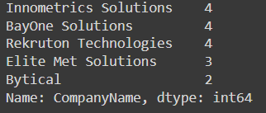




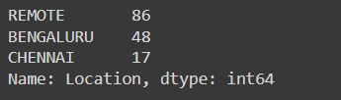
Important Parameters Analysis:
Top 5 applied companies
Most applied Job Role
Top 3 Job Location
Most Applied Job Type
Most jobs applied in the month of?
Top 3 platform jobs applied through?

